Slide 1

PROJECT DRAFT REPORT
[1]
Team Sprinters
Members: Bhupinder Jagwani, Moranda Gao, Niveditha Shanbhag, Pallavi Saboo, Pratik Deshmukh, Zhaoyi Zhang,
Madhavi Ranganadha
[1]: (n.d.). Retrieved from freepix.com: https://www.freepik.com/vectors/business-character

Slide 2







OUR TEAM
Photo
Photo
Pallavi Saboo
Role: Scrum Master
Bhupinder Jagwani
Role: Product Owner
Pratik Deshmukh
Role: Support
Photo
Photo
Moranda Gao
Role: Software Developer
Zhaoyi Zhang
Role: Software Developer
Niveditha Shanbhag
Role: Software Tester
Madhavi Ranganadha
Role: Data Analyst

Slide 3

COMPANY OVERVIEW
[3]
About Us:
Our Vision:
Our Mission:
Year founded: 2019
Headquarters: San Francisco, CA
Employees: 100
Revenue Stream:We provide ad services for publishers and earn revenue of 20% from the ad revenue, rest goes back to the publisher.[2]
Sprinters Inc provides products and services to online publishers to help them grow, operate their business, understand their readership and manage consumer data. We help publishers monetize their business by efficiently manage ad space on their site.[1]
Our aim is to help our customers make and keep more of their hard-earned revenues, by providing them tools, services and insights to make better decisions and investments.[1]
SPRINTERS ADTECH
[1] sovrn. (n.d.). More ways to grow your revenue. Retrieved from sovrn.com: https://www.sovrn.com/
[2] sovrn. (2022, March 8). All About Ad Servers. Retrieved from sovrn.com: https://www.sovrn.com/blog/all-about-ad-servers/
[3]freepik. (n.d.). Gradient s logo templates Free Vector. Retrieved from freepik.com: https://www.freepik.com/free-vector/gradient-s-logo-templates_13220136.htm#query=s&position=2&from_view=keyword

Slide 4
Problem Statement
Current Traffic:
2000 publishers, 10,000 websites, 1 Million + ad impressions on a daily basis
Current Data Processing:
Using MapReduce over Hadoop
Challenges:
Query processing in Hadoop using MapReduce is slow for terabytes of data
Building ML model for Customer Segmentation with existing architecture is hard
Customer Segmentation:
Increased conversion rates/ leads with strategically targeted ads
Discover potential niche markets for new product development/business expansion
[1] ProjectPro. (2022, April 6). Hadoop vs. Spark: Not Mutually Exclusive but Better Together. Retrieved from projectpro.io: https://www.projectpro.io/article/hadoop-vs-spark-not-mutually-exclusive-but-better-together/235

Slide 5
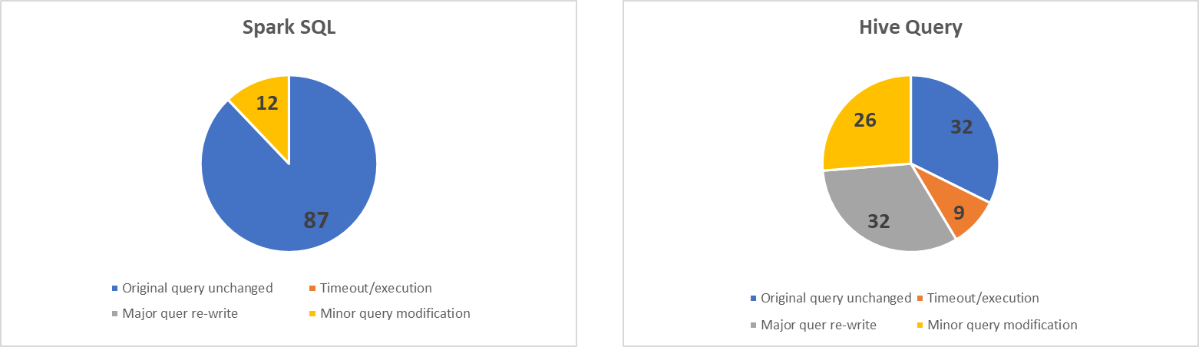
Spark vs Hadoop Query Performance
99 queries were tested on 50GB database
[1]
12 queries required minor modification
Took 30 mins to complete
9 queries had execution error and timed out after 5 hours
Took 5 hours to complete
26 queries needed modification(mainly type casts)
[1] glensheffield. (2013, November 3). IBM Big SQL Benchmark vs. Cloudera Impala and Hortonworks Hive/Tez. Retrieved from shefsite.wordpress.com: https://shefsite.wordpress.com/2014/11/03/ibm-big-sql-benchmark-vs-cloudera-impala-and-hortonworks-hivetez/

Slide 6

OSS PROJECT & HYPOTHESIS
Project Objective:
Integrate Apache Spark in Hadoop environment
Success Criteria:
20% more growth in revenue / customer acquisition with the renewed Marketing Strategy
Reduce query processing time by at least 60%, leading to increased productivity of system and developer
[2]
[1] shopify. (n.d.). Customer Segmentation. Retrieved from shopify.com: https://www.shopify.com/encyclopedia/customer-segmentation
[2](n.d.). Retrieved from freepix.com: https://www.freepik.com/search?format=search&query=customer%20segmentation&selection=1&type=vector

Slide 7
COMPETITIVE ANALYSIS
 | HADOOP | SPARK
REAL TIME | None | Near Real time
PERFORMANCE | Slower | 100 times faster
LATENCY | High | Low
MACHINE LEARNING | Requires Apache Mahout. However, there are performance limitations | Supports analytical frameworks and machine learning library
ITERATIVE PROCESSING | Does not support | Supports Iterative Processing
EASE OF USE | Complex framework, no interactive mode | User friendly API, interactive mode
USE CASES | Inventory Forecasting Fraud detection Supply chain efficiency Historical data analysis | Customer Segmentation Marketing research Recommendation engines Achieving quick results
[1]
[1]: Lawton, G. (2022, February 17). Hadoop vs. Spark: An in-depth big data framework comparison. Retrieved from techtarget.com: https://www.techtarget.com/searchdatamanagement/feature/Hadoop-vs-Spark-Comparing-the-two-big-data-frameworks

Slide 8
SWOT ANALYSIS - SPARK
[1]
STRENGTHS
WEAKNESSES
Run workloads faster
Write applications quickly in Java, Scala, Python & SQL
Access diverse data sources
Used in wide range of organizations
No File Management
Problem with small file
Memory Management
OPPORTUNITIES
THREATS
Real time data processing
Seamlessly integrating complex capabilities
Simplify challenging and compute-intensive task of processing high volumes of data.
Various technologies overtaking spark
Memory processing can be expensive
[1]:Renova Cloud. (n.d.). AN INTRODUCTION TO AND EVALUATION OF APACHE SPARK FOR BIG DATA ARCHITECTURES. Retrieved from renovacloud.com: https://renovacloud.com/an-introduction-to-and-evaluation-of-apache-spark-for-big-data-architectures/?lang=en

Slide 9





USERS / PERSONAS
[1]
[1]
[1]
[1]
[1]
Data Architect
Data Analyst
Product Manager
Marketing Manager
Software Tester
[1]: (n.d.). Retrieved from freepix.com: https://www.freepik.com/vectors/business-character

Slide 10
USER STORIES
 | PERSONA | THEME | USER STORY CONTENT | ACCEPTANCE CRITERIA
1. | Data Architect | Data Access | As a data architect, I want to maintain HDFS and provide modules/libraries of limited data access to data analysts so that data analysts can successfully access to the data. | Data analysts can only access to the data they need to perform customer segmentation tasks. HDFS is not affected by Spark implementation.
2. | Data Analyst | Customer Data Analysis | As a data analyst, I want to provide analysis regarding our existing customers so that I can meet the requirements of the asking teams | The results of the analysis should check off all the requirements from the asking team.
3. | Product Manager | Build customer centric products | As a product manager, I want to develop products that would resonate with specific target audience so that I can build products that are viable for the business. | Product sales for the new target segment should increase sales by at least 20%

Slide 11
USER STORIES
 | PERSONA | THEME | USER STORY CONTENT | ACCEPTANCE CRITERIA
4. | Marketing Manager | Marketing Strategy | As a marketing manager, I want to understand and analyze the market, so that I can develop, implement and execute strategic market plans. | After transforming from Hadoop to Apache Spark, the customer segmentation results help generate at least 30% more leads than before.
5. | Software Tester | Dataframe Architecture Testing | As a software tester, I will ensure that module/library released by the data architect has no major bugs so that data analyst can access the module/library successfully without experiencing major issues | Data Analyst should be able to access the module/library without any major issues like module/library failure or unable to retrieve data from the module

Slide 12

System Architecture

Slide 13
Existing System Architecture
Data Visualization
Data Access
Data Processing Layer
Cluster Resource Management
Data Storage Layer
Data Visualization
Data Access
Data Processing Layer
Cluster Resource Management
Data Storage Layer
[1]
Real Time Dashboards or Tableau
(Java, C++, Python)
Mahout
(Machine Learning)
Pig (DataFlow)
Hive (SQL)
MapReduce
YARN
HDFS(On premise)
(Hadoop Distributed File System)
[1]: Kaplarevic, V. (2020, May 25). Apache Hadoop Architecture Explained (with Diagrams). Retrieved from phoenixnap.com: https://phoenixnap.com/kb/apache-hadoop-architecture-explained
]

Slide 14
Future System Architecture
Data Visualization
Data Access
Data Processing Layer
Cluster Resource Management
Data Storage Layer
Data Visualization
Data Access
Data Processing Layer
Cluster Resource Management
Dta Storage Layer
Data Visualization
Data Access
Data Processing Layer
Cluster Resource Management
Data Storage Layer
[1]
Real Time Dashboards or Tableau
(Java, C++, Python)
Real Time Dashboards or Tableau
(SQL/Java/Python/Scala/SparkR)
Mahout
(Machine Learning)
Pig (DataFlow)
Hive (SQL)
Spark Streaming
Spark SQL
Spark MLib
DataFrames
MapReduce
Apache Spark
(Spark Core Engine, Batch & Real time Processing)
YARN
YARN
HDFS(On premise)
(Hadoop Distributed File System)
HDFS or Cloud Storage
[1]: Chinchole, A. (2021, October 7). Hadoop vs Spark: A Comparative Study. Retrieved from cloudlytics.com: https://cloudlytics.com/hadoop-vs-spark-a-comparative-study/

Slide 15
Roadmap

Slide 16
Roadmap
Customer Segmentation Preparation
Build Marketing Strategy
Q1
Q2
JANUARY
FEBRUARY
MARCH
APRIL
MAY
JUNE
Design & Development
Determine Business Requirements
Identify key customer segments
Enhance Product /develop features based on insights
Customer requirement analysis for segments
Design Spark Architecture
Integration
Dashboards
Integrate Spark on
existing HDFS layer
Marketing strategy
Based on customer segments
Infrastructure
Database Improvement
Library Upgrades
Change Management
Train employees
on using Spark
Update the API documentation

Slide 17
Sprint Planning
&
Incremental Model

Slide 18
Sprint Plan : Incremental + Scrum (Blended model)
Sprint 1
Sprint 2
Sprint 3
Sprint 4
Sprint 5
Sprint 6
Increment 1
Increment 2
Increment 3
Increment 4
Increment 5
Increment 6
JANUARY
FEBRUARY
MARCH
APRIL
MAY
JUNE
Determine Business Requirements
Install Spark in
Hadoop
Access Spark
Prepare Data for ML
Build ML model for customer segmentation
Documentation & Dashboards
Gather Business requirements from product team
collect data
Test & Train data
Update API document
Setup Spark Master Server
Set environment variables
Create RDD
Gather Business requirements from marketing team
Slave & Master Server Setup
validate the services running in nodes
Clean data
Modify ML algorithms
Visualizations
configure our DataNodes
Run queries
Incorporate feedback & build library modules
Business decision based on insights
Start Spark Services

Slide 19
ROI & ROV
Notes:
Title Slide

Slide 20
Estimated Labor Saving
Given:
1 year Project
Number of Full Time Employees Associated: 7; with 5 Data Analyst, 2 Data Architect
Average Yearly Salary : $100K
Cost of Employees per year : 7*100*1 = $700K
Other costs (burden rate) : 700K * .27 = $189K
Total Cost per year : $889K
Labor Saving Methodology Applied:
50 GB of data with 100 queries requires 5 hours with Hadoop[1]
50 GB of data with 100 queries requires 1 hour with Spark[1]
4 hours of saving per day per employee
4 hours per day * 30 days * 5 employees =120 * 5 hours= 600 man-hours
An employee works 170 hours per month
600/170 = 3.5 ~ 3 Full time employees ~ 107K per month saving per employee~ 321 K per year of saving if we move 3 employees to other complex projects
Assumptions:
Salary of Data Analyst and Data Architect according to the industry standards ($100K)
Number of working hours of a Full Time employee (8 Hours per day)
Burden Rate (27%)
[1]:[glensheffield. (2013, November 3). IBM Big SQL Benchmark vs. Cloudera Impala and Hortonworks Hive/Tez. Retrieved from shefsite.wordpress.com:https://shefsite.wordpress.com/2014/11/03/ibm-big-sql-benchmark-vs-cloudera-impala-and-hortonworks-hivetez/
Notes:
Simple Slide

Slide 21
Estimated Operational Cost Savings
Under Hadoop the company was maintaining Small Data Center (500 square feet) with costs from the following table[1][3]
In a Data Center, the hierarchy is as follows:
For Sprinters the Operational Cost Savings come from calculating costs for 3 Racks/6700 Nodes (Hadoop) and 1 Rack/2500 Nodes (Spark)
NODE
SERVER
RACK
DATA
CENTER
1 Server
256 Nodes
1 Rack
14 Servers
1 Datacenter
5 Racks
[1]: Hall, A. (2019, March 6). Cassandra Datacenter and Racks. Retrieved from datastax.com: https://www.datastax.com/blog/distributed-database-things-know-cassandra-datacenter-racks
[2]: Data Center Colocation – Build vs. Buy. (n.d.). Retrieved from 365datacenters.com: https://365datacenters.com/resources/white-papers/data-center-colocation-build-vs-buy/
[3]: baeldung. (2021, October 9). Cluster, Datacenters, Racks and Nodes in Cassandra. Retrieved from baeldung.com: https://www.baeldung.com/cassandra-cluster-datacenters-racks-nodes
Notes:
Simple Slide

Slide 22
Architectural, Engineering, Power Construction and Environment Costs of DataCenter
 | Hadoop[1][2] | Spark [1][2]
Total Data | 10000 Gb | 10000 Gb
Nodes | 6700 Nodes | 2500 Nodes
Server | 26 | 10
Rack | 3 | 1
Engineering | $200K | $120K
Permits | $5435 | $5435
Utility Improvements | $7782 | $3432
Generator and Enclosures | $42575 | $19566
Generator conduit and Cabling | $2895 | $1347
Data Center Lighting | $2826 | $1491
Facility Management System | $2636 | $1288
Internet, Fiber, Local Loop Charges | $30,000 | $1358
Electrical Maintenance Costs | $2385 | $1050
Total Operational Costs | $ 296,000 | $ 154,967
[1]: Allen, M. (2018, October 15). Understanding Data Center Costs Breakdown Is The Key To Better Price Comparison Even Under Disparate Pricing Models. Retrieved from datacenters.com: https://www.datacenters.com/news/understanding-data-center-costs-breakdown-is-the-key-to-better-price-comparison-
[2]: Aurelio, D., & Ferrao, J. (n.d.). Category: Spark. Retrieved from datacenternotes.com: https://datacenternotes.com/category/spark/
Notes:
Simple Slide

Slide 23
RoV
[1]
Criteria | Expected Values
Key Insights | Scalable framework for faster analysis of complex ; Ability to connect to large data sets within object store data containers
Machine Learning and AI | Open source scientific and machine learning packages, such as Scikit Learn and astro ML along with powerful programming and data constructs Capability to look at the old and new data through lenses that produce quick insights for segmentation and various other goals
Immediate Results | Derive insights almost immediately, with extensive usage of Spark and exploring more than triple the amount of data in a matter of months. Perform near live processing to thin slice more data.
[1]: Dimolarov, N. (2020, March 20). How to build Spark from source and deploy it to a Kubernetes cluster in 60 minutes. Retrieved from towardsdatascience.com: https://towardsdatascience.com/how-to-build-spark-from-source-and-deploy-it-to-a-kubernetes-cluster-in-60-minutes-225829b744f9
Notes:
Simple Slide

Slide 24
Risk Management & SW Disasters

Slide 25
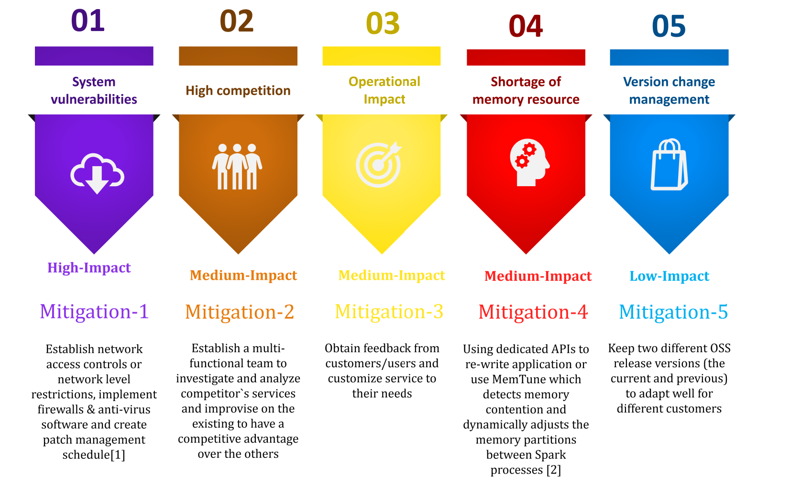
Risks & Mitigation
[1]: Apache Spark. (n.d.). Spark Security. Retrieved from spark.apache.org: https://spark.apache.org/docs/2.4.3/security.html
[2]: Vicent Sanz Marco, B. T. (2017). Improving Spark Application Throughput Via Memory Aware Task Co-location: A mixture of experts approach. Nevada.

Slide 26
THANKS
Team Sprinters
Members: Bhupinder Jagwani, Moranda Gao, Niveditha Shanbhag, Pallavi Saboo, Pratik Deshmukh, Zhaoyi Zhang,
Madhavi Ranganadha
SPRINTERS ADTECH

Slide 27
IN-CLASS DRAFT PROJECT REPORT REVIEW
Feedback:
Positive
Completed within time
Template design
Critical
Clear confusion about batch processing performance
Have incorporated in the slide 13 in the draft report

